Slide 1


Slide 2








NICOLAS
MARCOTTE
DANIEL
BILOTTA
ALEXANDRE
IMBEAULT
BUSINESS
DOMINIC
SAVOIE
VINCENT
DUBEDOUT
SEBASTIEN
LEMIEUX
CODERE
DEVELOPPERS
DESIGNERS
PIERRE
FOUCART
GABRIEL
GERMAIN

Slide 3
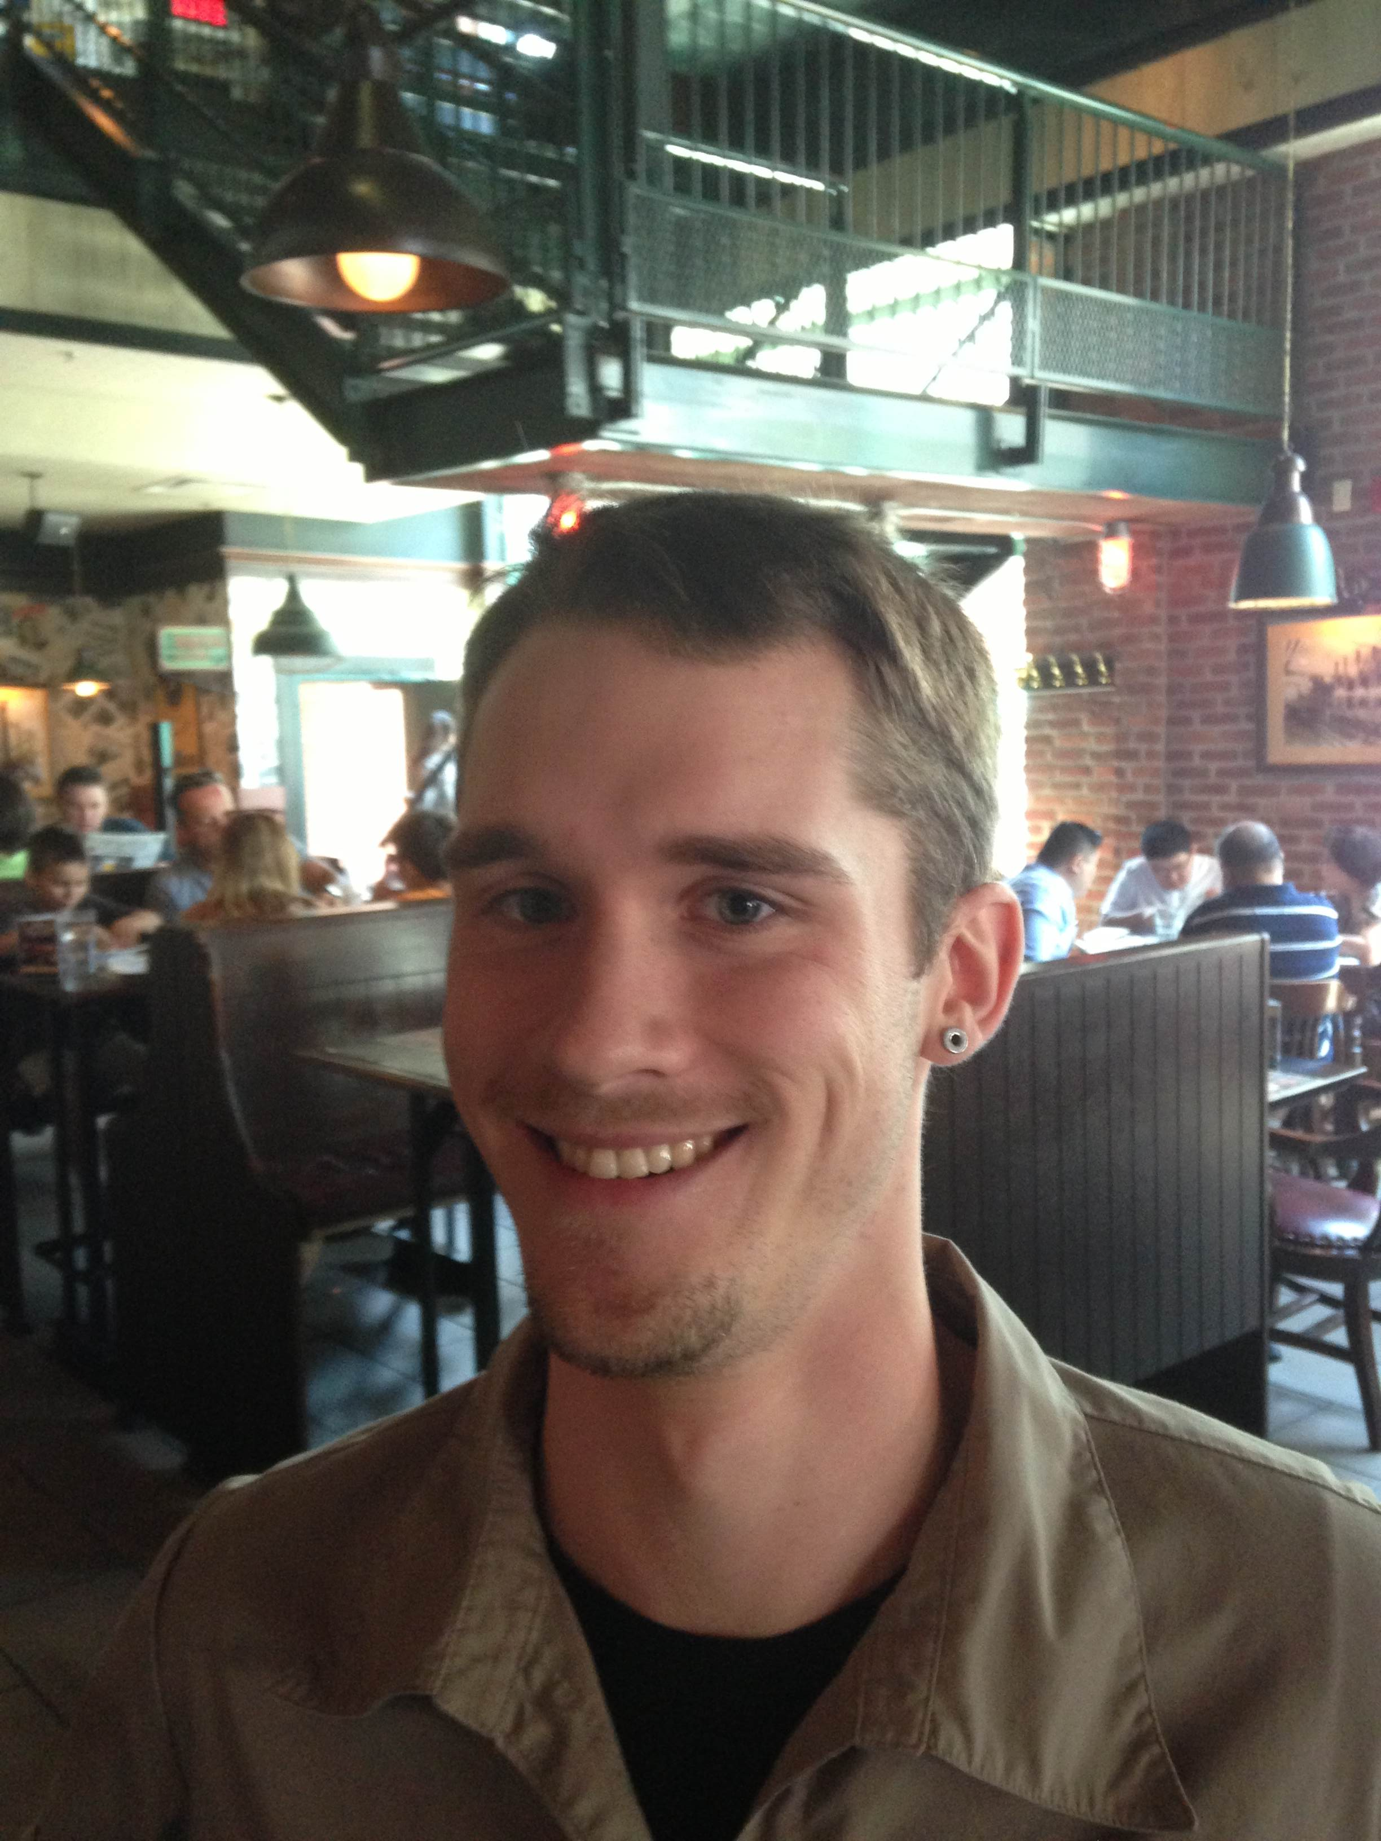
Antoine
Subscribe to a gym
Went for 3 weeks
Went back 2 months later for another 3 weeks
Want to go back but he his too busy and/OR simply lazy
DESIRE | MOTIVATION | GYM FOCUS | DIFFERENCIATION | RETENTION

Slide 4
38%
DETERMINED
FIT
HAPPIER
25%
CONFIDENT
6%
13%
FOCUSED
19%
EMPOWERED
COMMUTE TIME
TO JOIN THE GYM
CHANGE OF LOCATION
TOO EXPENSIVE
CHANGE OF WORK
LACK OF MOTIVATION
PRODUCTIVE
HEALTHIER

Slide 5
What would help you succeed?
WE CREATE A UNIQUE EXPERIENCE
THAT ENGAGES GYM MEMBERS WHO WOULD NOT OTHERWISE BE.

Slide 6
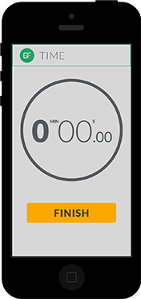
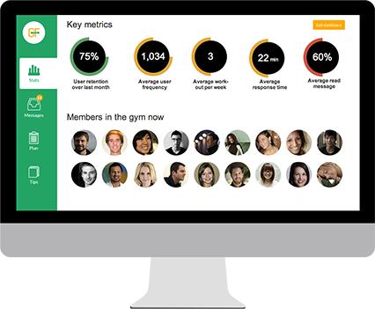
PERSONAL INTERACTIONS AT LOW COST
Advice
Motivation
Retention
Data on their training
GYM
MEMBER
DESIRE | MOTIVATION | GYM FOCUS | DIFFERENCIATION | RETENTION

Slide 7
DEMO

Slide 8
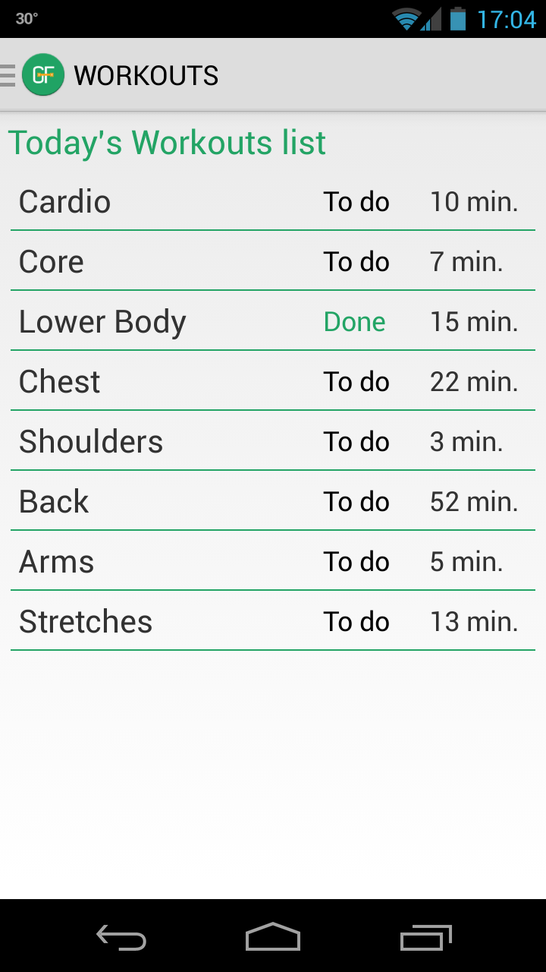
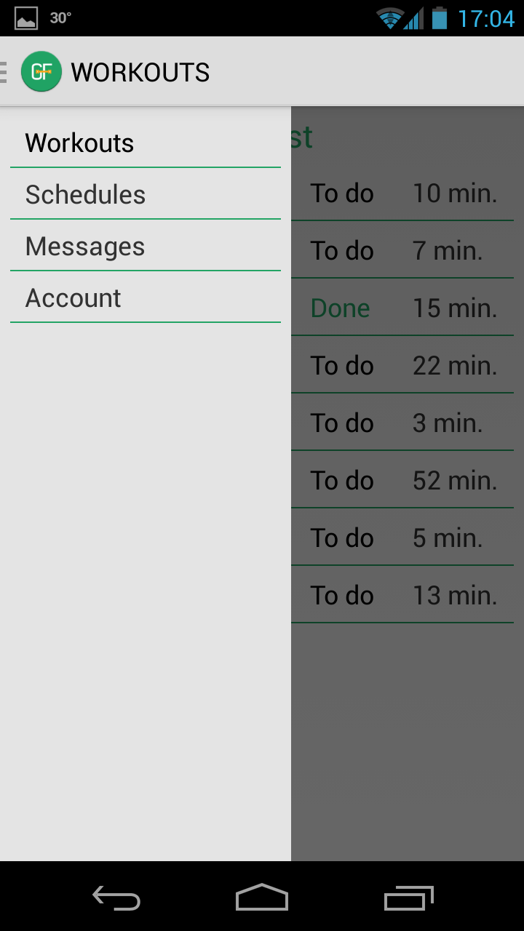

Slide 9
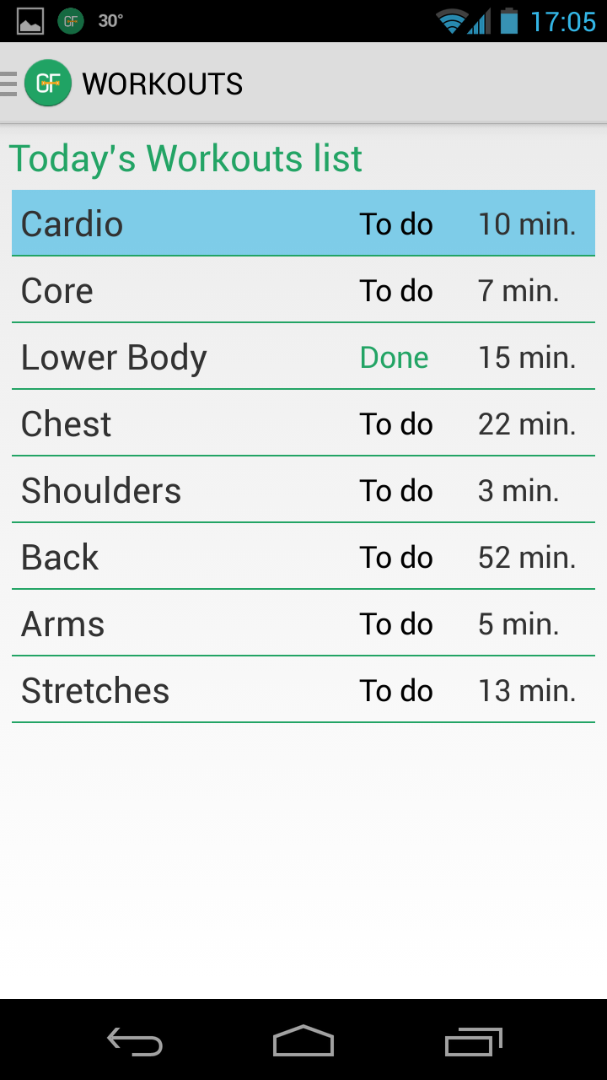
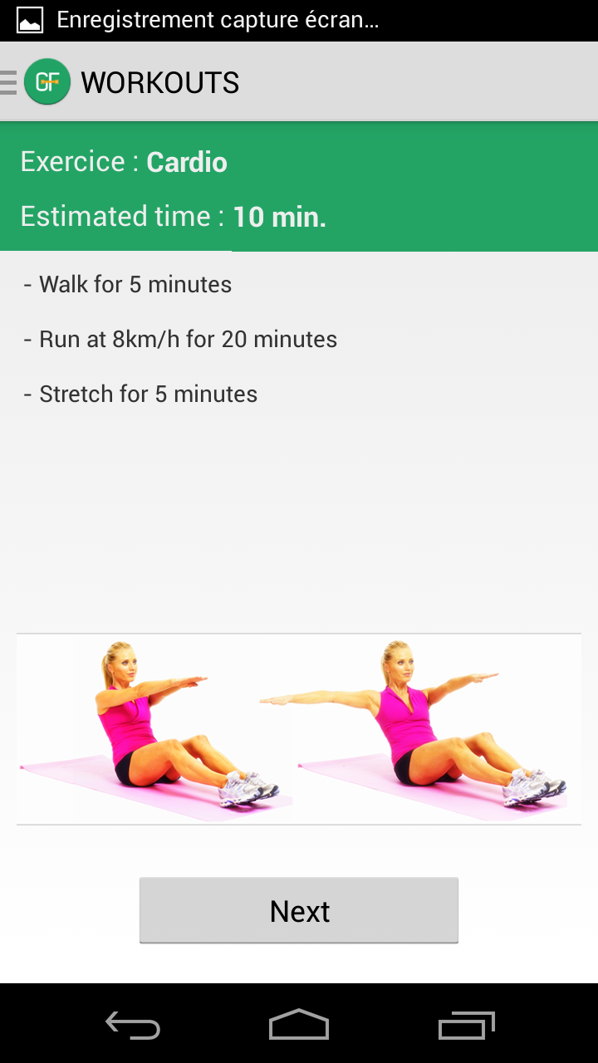

Slide 10
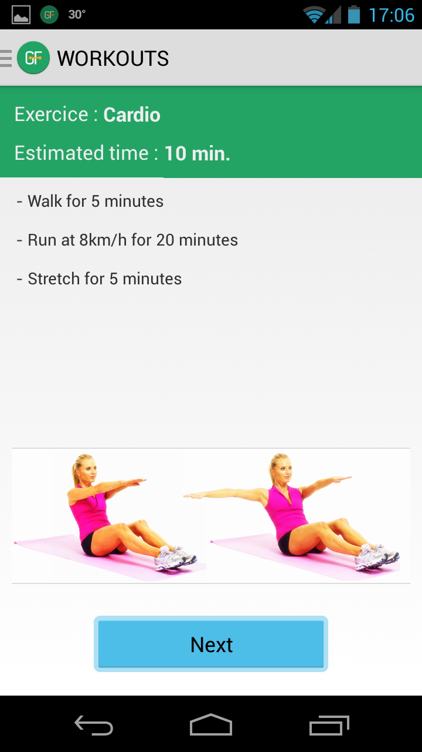
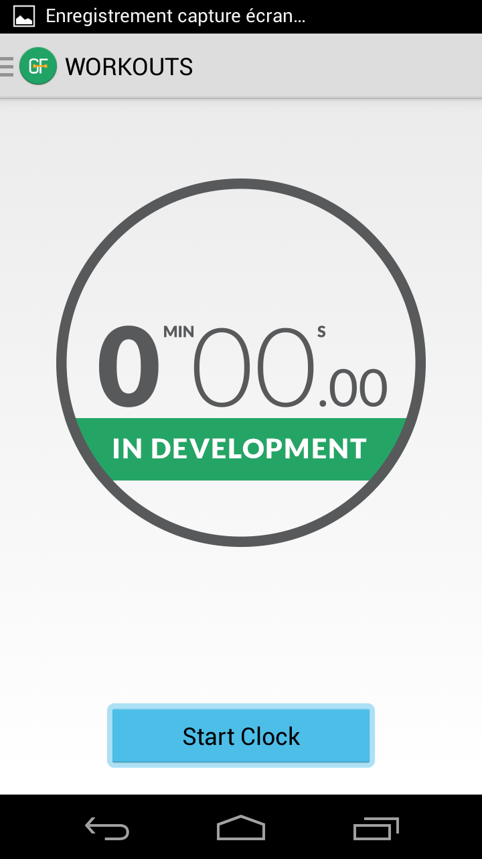

Slide 11
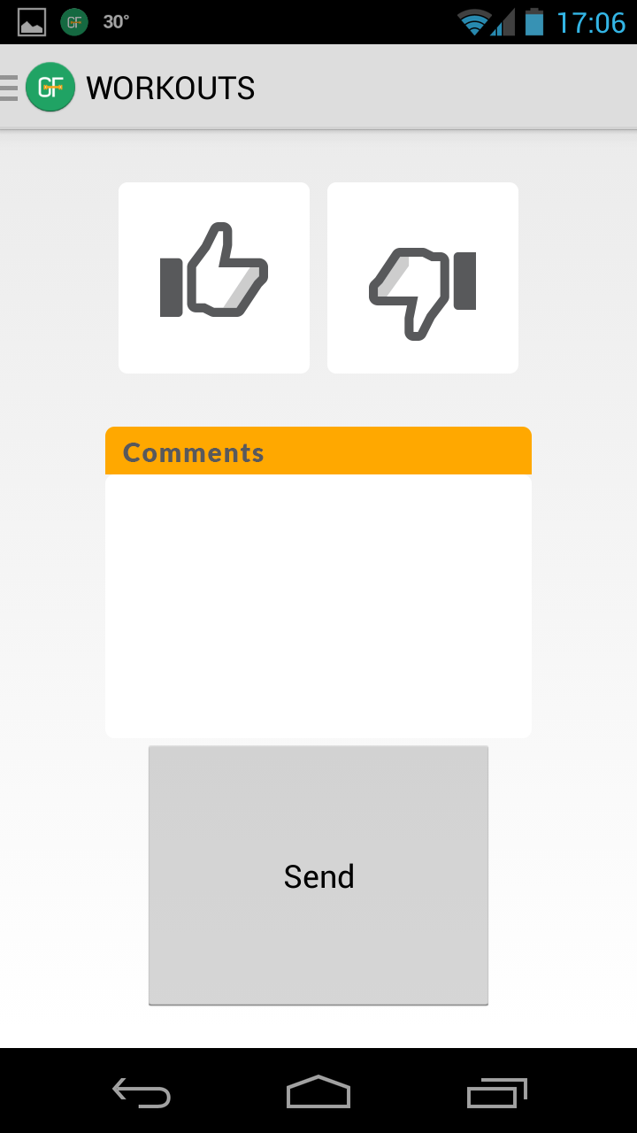
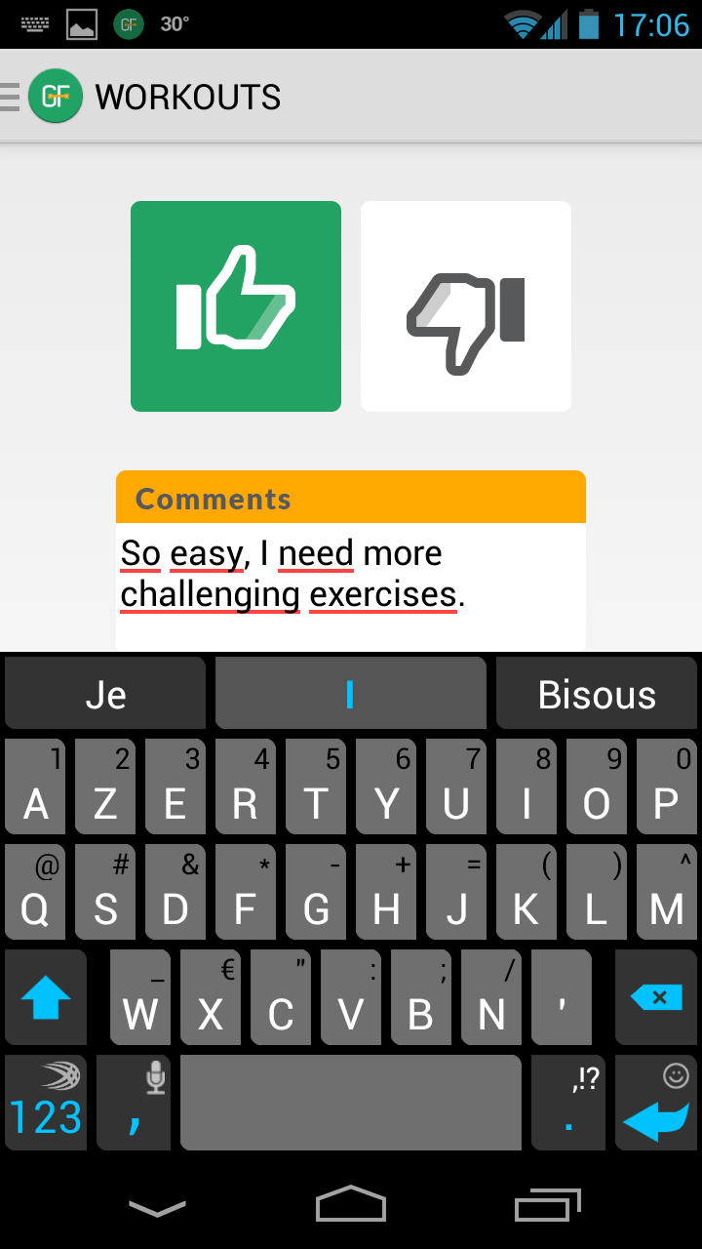

Slide 12
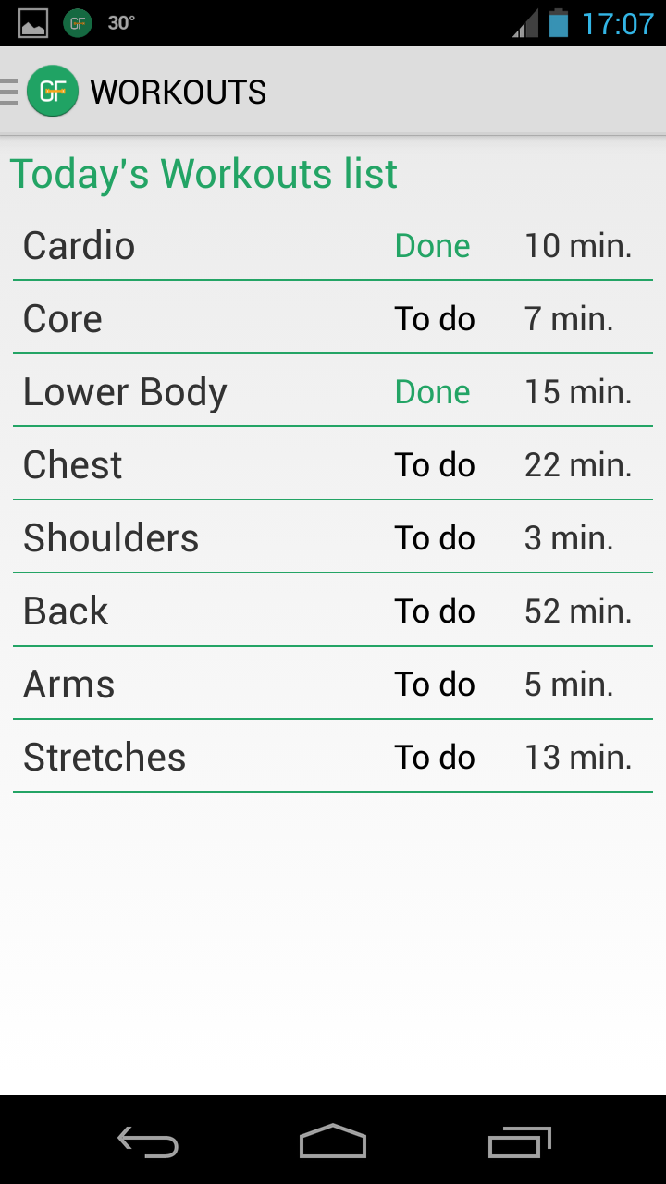
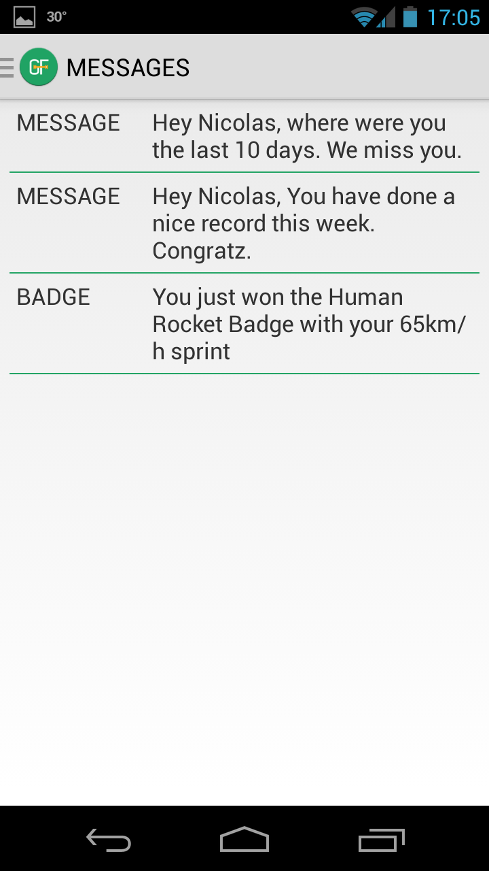

Slide 13
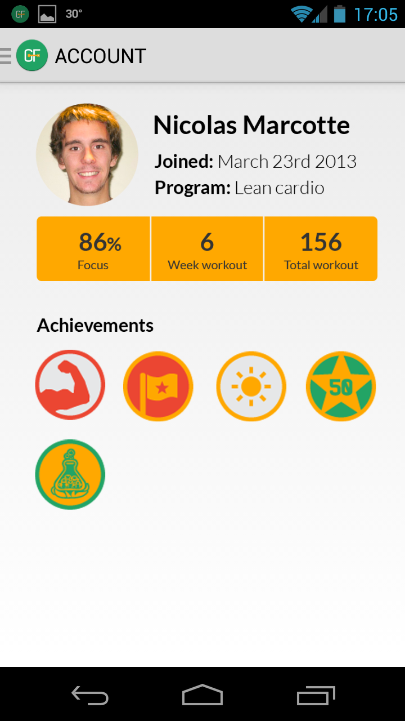

Slide 14
MEMBERS VALUE ADDED
EXPERIENCE
Gamification
Personal advice
Communication
GOALS SUCCESS
MAKES A DIFFERENCE
DESIRE | MOTIVATION | GYM FOCUS | DIFFERENCIATION | RETENTION

Slide 15
GYM VALUE ADDED
MARKETING TOOL
Advocates
Retention
Data
PROMOTIONAL CHANNEL
DESIRE | MOTIVATION | GYM FOCUS | DIFFERENCIATION | RETENTION

Slide 16
MONETIZATION
Monthly fee → X members access through dashboard → Gym Focus Marketing tool
Customization
→ White label
DESIRE | MOTIVATION | GYM FOCUS | DIFFERENCIATION | RETENTION
Notes:
Letter of intention: price related

Slide 17

RETENTION
DIFFRENCIATION
MOTIVATION
DESIRE

Slide 18
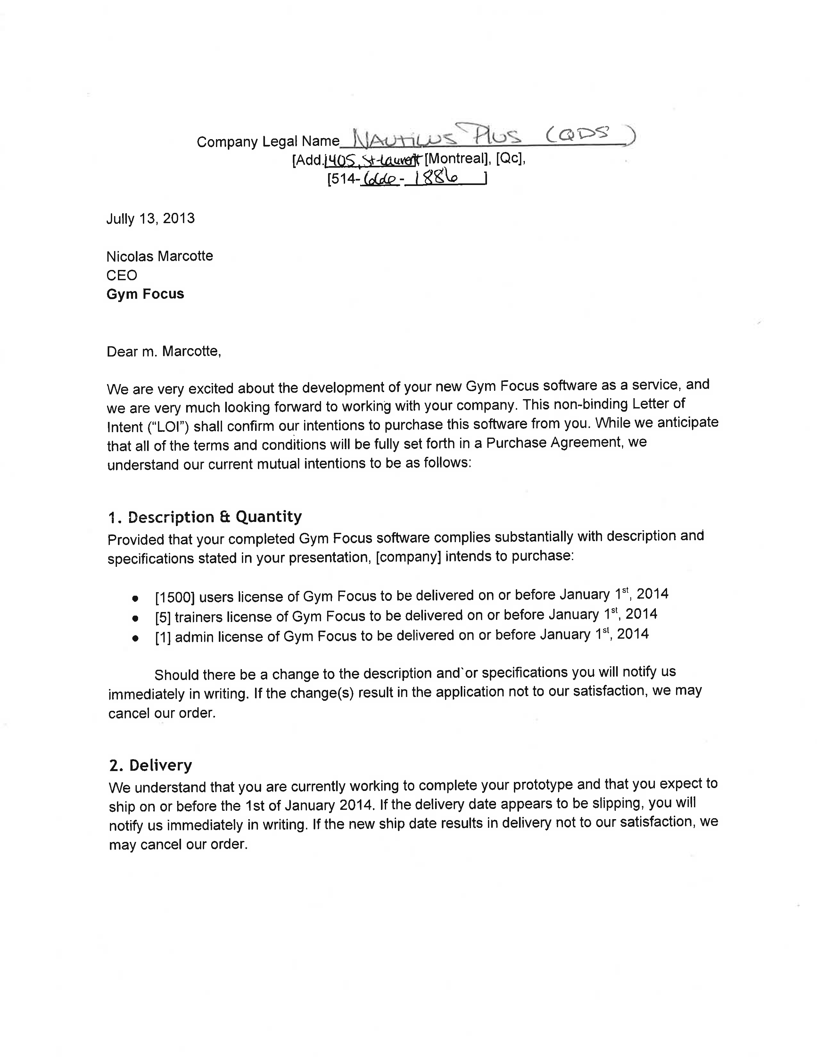
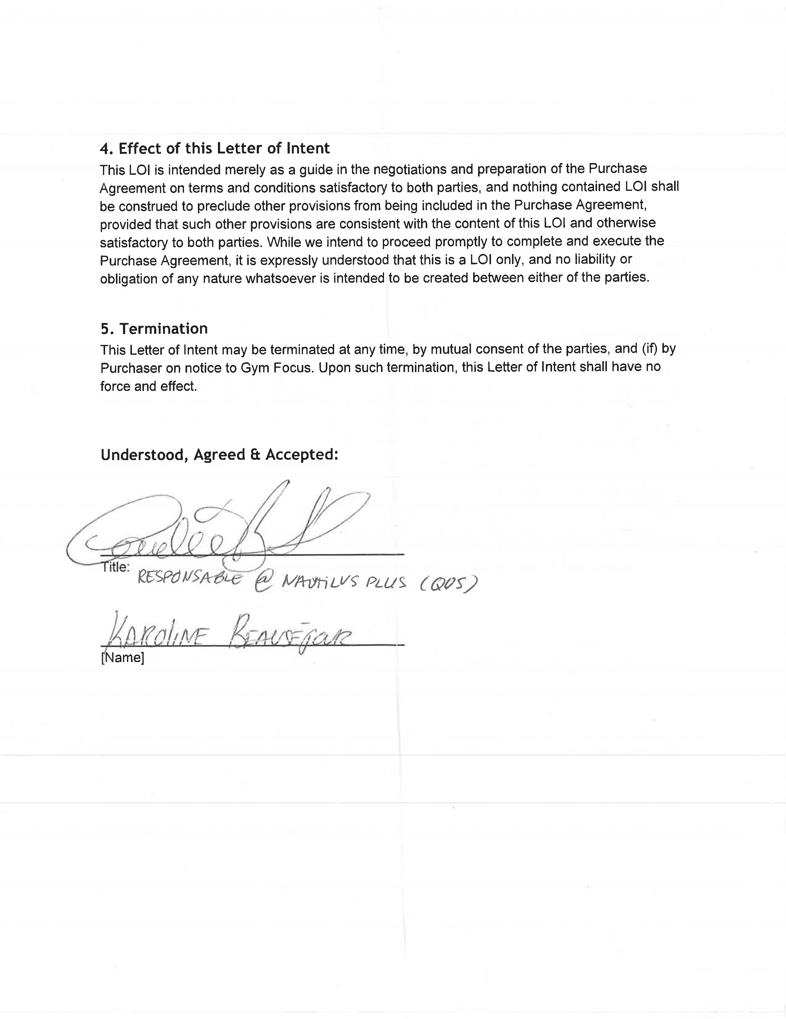
LETTER OF INTENTION

